Slide 1
Creating Accessible Word Documents 101
Presenter:
Heather Thomas
Accessibility Services Associate

Slide 2
Heather Thomas, Accessibility Services Associate
Heather Thomas joined the Accessibility Services Department at The Carroll Center in September of 2019. Previously, she was an Assistive Technology instructor at The Carroll Center for 17+ years working directly with individuals who are blind or visually impaired. She is proficient in the use of popular screen reading and screen magnification software for Windows and Mac computers, as well as iOS devices. She has also seen the impact that accessible (and inaccessible) digital content has on users. In her current role, she supports various digital accessibility projects. She has a special interest in document accessibility and training sighted individuals to use screen reading software to test their content.

Slide 3
Learning Objectives
Describe 2 reasons why document accessibility should matter to you
Identify 2 types of assistive technology that may be used by a person with a disability
Explain the key accessibility components discussed today and how to implement them
Locate the Word Accessibility Checker

Slide 4
Why Does Document Accessibility Matter?
Who does it affect?
Workforce diversity
Legal aspects
Positive company image

Slide 5
Examples of Assistive Technology
Screen reading software
Refreshable Braille displays
Screen magnification software
Speech recognition software
Low tech items

Slide 6
Screen Reader Demonstration 1

Slide 7
Unlocking Some Key Accessibility Components
Headings
Lists
Color considerations
Alternative (Alt) Text

Slide 8
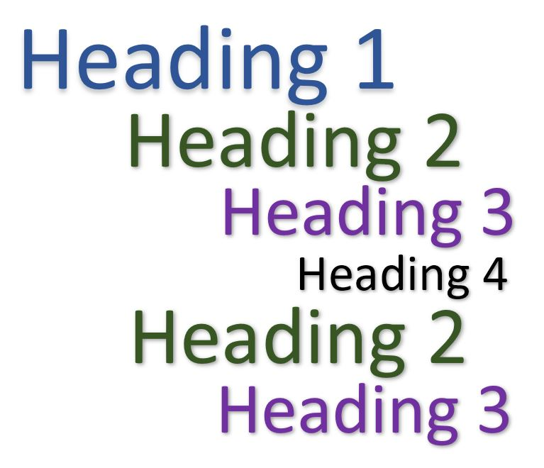
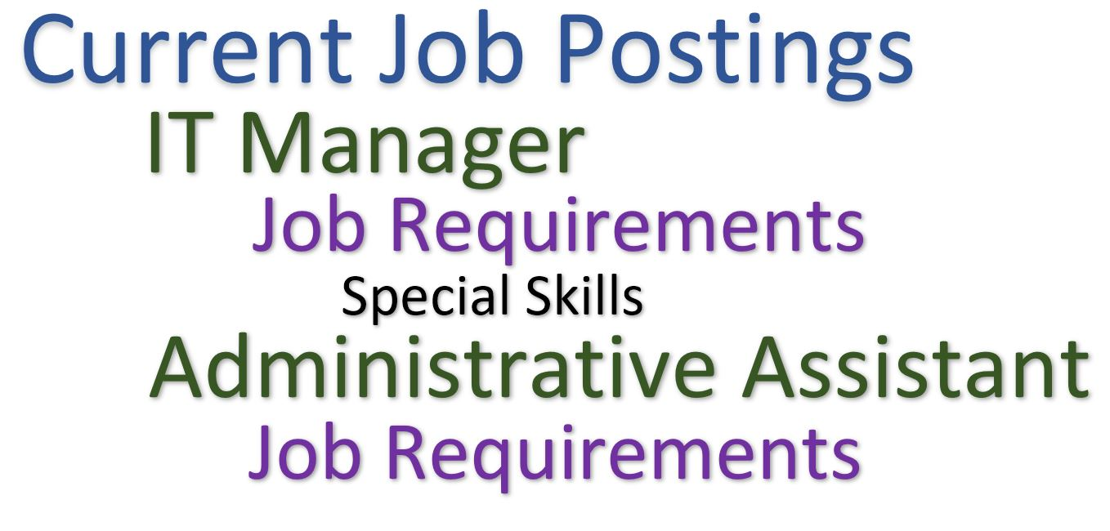
#1 Headings
What are Word Styles?
Use hierarchical headings for semantic structure
Enable efficient screen reader navigation
Help sighted users as well
Include an automated Table of Contents for longer documents

Slide 9
#2 Lists
Use built-in list styles to enhance visual and nonvisual comprehension
Home tab of ribbon
Ordered vs. Unordered
Nesting within a list

Slide 10
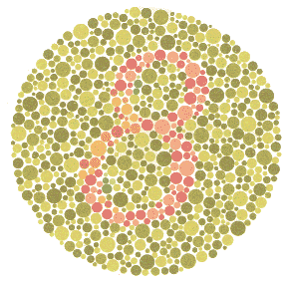
#3 Color Considerations
Do not use color as the only means of conveying information
Avoid color combinations that may prove difficult or impossible for some individuals to identify
Use sufficient color contrast between foreground and background

Slide 11
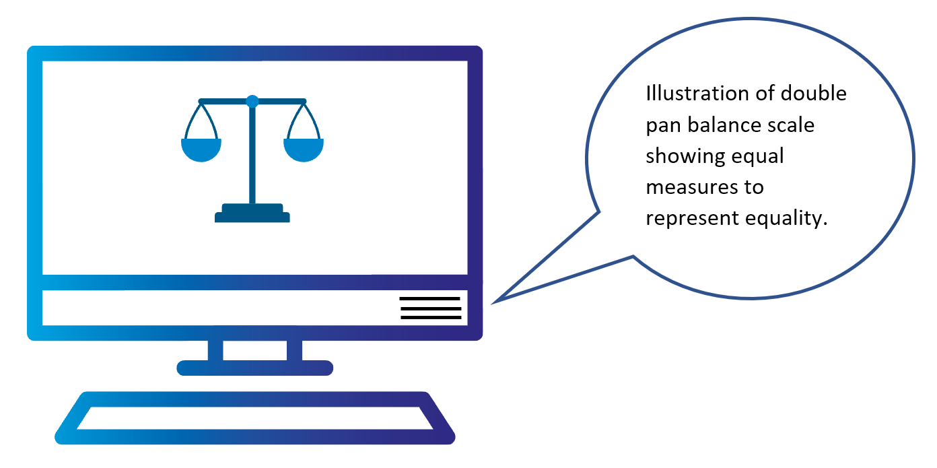
#4 Alternative Text (Alt Text)
Create succinct but descriptive alt text
Select “mark as decorative” for nonessential images
Don’t include the words ‘image’ or ‘picture’
Images that are more complex, such as charts or graphs, may require additional steps to convey their meaning

Slide 12
Alt Text Example

Slide 13
Miscellaneous Things to Avoid
Avoid creating “forms” in Word format
Avoid textboxes and Word Art
Avoid placing images in front of or behind text
Avoid using complex tables, layout tables, or images of tables
Avoid using spaces or tabs to create the look of columns

Slide 14
Conversion from Word to PDF
Headings
Bulleted & numbered lists
Alternative text for images
Colors
Marked column/row headers for simple tables
Hyperlinks
Marked proofing language

Slide 15
Myth Busters!
You can create semantic headings by increasing font size, changing color, and making text bold
If it looks like a list, it’s a list, right?
You should write the word “image” or “picture” in your alternative (alt) text descriptions
You should never use color to convey meaning

Slide 16
Screen Reader Demonstration 2

Slide 17
Strategies and Tools for Checking Accessibility
Appoint Accessibility Subject Matter Experts
Microsoft Word Accessibility Checker (includes color contrast check)
Other color contrast checkers:
Colour Contrast Analyser (CCA)
Screen Readers:
JAWS (Job Access with Speech)
NVDA (Non-Visual Desktop Access)

Slide 18
Review
Describe 2 reasons why document accessibility should matter to you
Identify 2 types of assistive technology that may be used by a person with a disability
Explain the 4 key accessibility components discussed today and how to implement them
Locate the Word Accessibility Checker

Slide 19
Digital Accessibility Services
Accessibility Compliance Audits
Skilled User Testing
Accessible Document Creation & Remediation
Usability Study recruitment and hosting support
Customized Accessibility Training
Digital Accessibility Consulting
Heather Thomas
Accessibility Services Associate
Heather.Thomas@Carroll.org
617-969-6200, ext. 208

